Slide 1


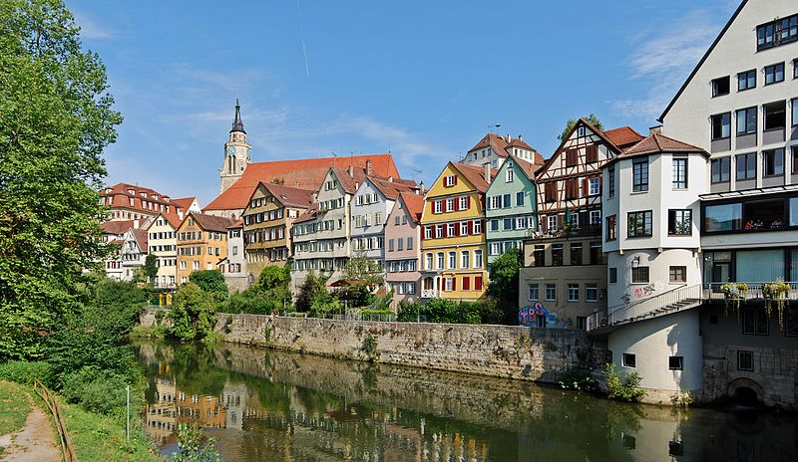
Predictive processing and active inference
Karl Friston, University College London
How much about our interaction with – and experience of – our world can be deduced from basic principles? This talk reviews recent attempts to understand the self-organised behaviour of embodied agents, like ourselves, as satisfying basic imperatives for sustained exchanges with the environment. In brief, one simple driving force appears to explain many aspects of action and perception. This driving force is the minimisation of surprise or prediction error that – in the context of perception – corresponds to Bayes-optimal predictive coding. We will look at some of the phenomena that emerge from this principle; such as hierarchical message passing in the brain and the perceptual inference that ensues. I hope to illustrate the ensuing brain-like dynamics using models of bird songs that are based on autonomous dynamics. This provides a nice example of how dynamics can be exploited by the brain to represent and predict the sensorium that is – in many instances – generated by ourselves. I hope to conclude with an illustration that illustrates the tight relationship between pragmatics of communication and active inference about the behaviour of self and others.

Slide 2

Overview
The anatomy of inference predictive coding
graphical models
canonical microcircuits
Birdsong perceptual categorization
sensory attenuation
a birdsong duet

Slide 3
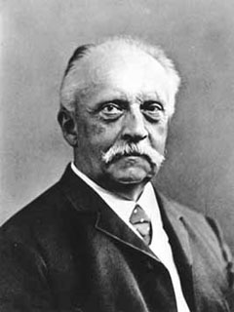
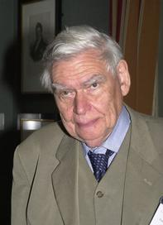
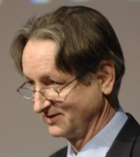
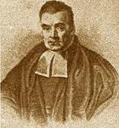

“Objects are always imagined as being present in the field of vision as would have to be there in order to produce the same impression on the nervous mechanism” - von Helmholtz
Hermann von Helmholtz
Richard Gregory
Geoffrey Hinton
The Helmholtz machine and the Bayesian brain
Thomas Bayes
Richard Feynman

Slide 4
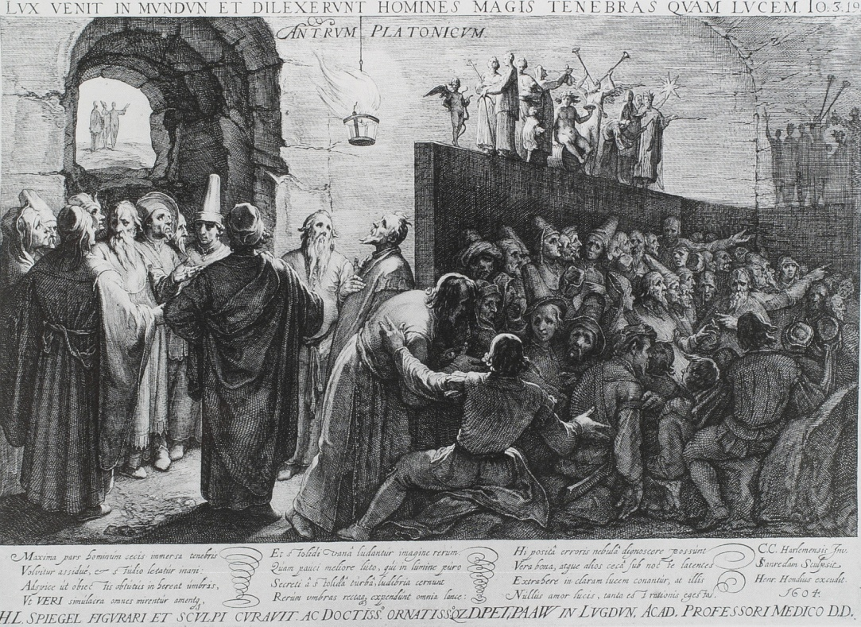
“Objects are always imagined as being present in the field of vision as would have to be there in order to produce the same impression on the nervous mechanism” - von Helmholtz
Hermann von Helmholtz
sensory impressions…
Richard Gregory
Plato: The Republic (514a-520a)

Slide 5
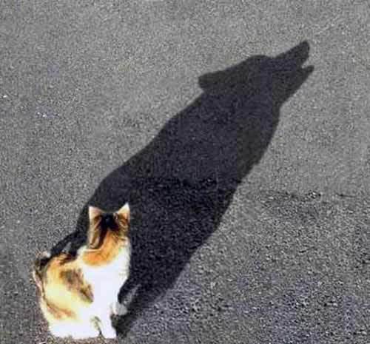
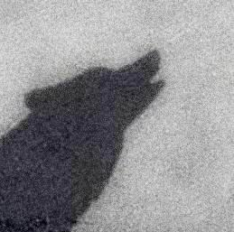
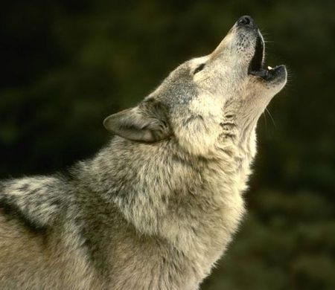
Bayesian filtering and predictive coding
changes in expectations are predicted changes and (prediction error) corrections
prediction error

Slide 6

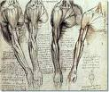
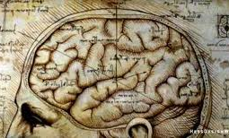
Minimizing prediction error
sensations – predictions
Prediction error
Action
Perception
Change sensations
Change predictions

Slide 7
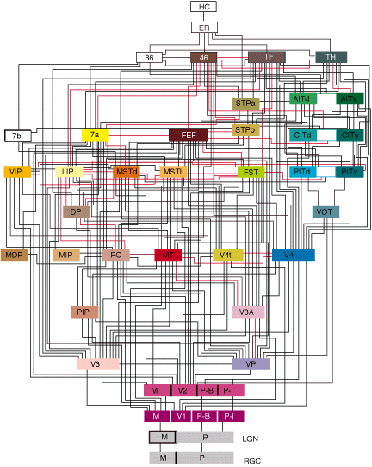
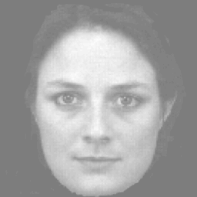
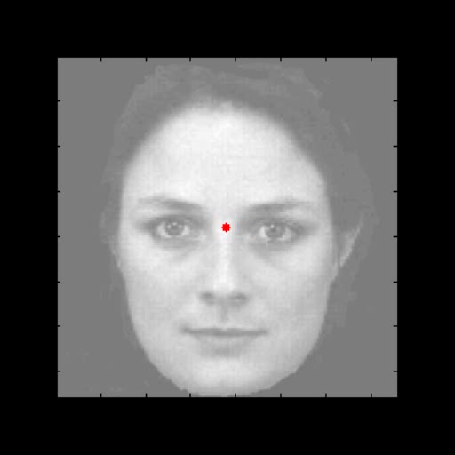
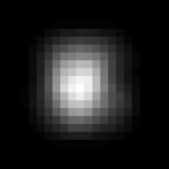
Generative models
A simple hierarchy
what
where
Sensory fluctuations

Slide 8
From models to perception
A simple hierarchy
Generative model
Descending
predictions
Model inversion (inference)
Predictive coding
Expectations:
Ascending prediction errors
Predictions:
Prediction errors:

Slide 9
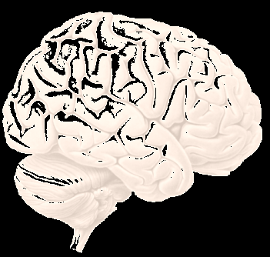
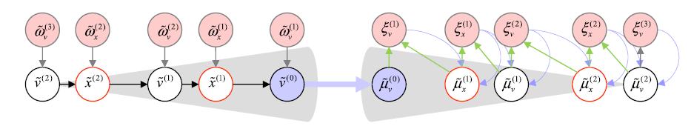
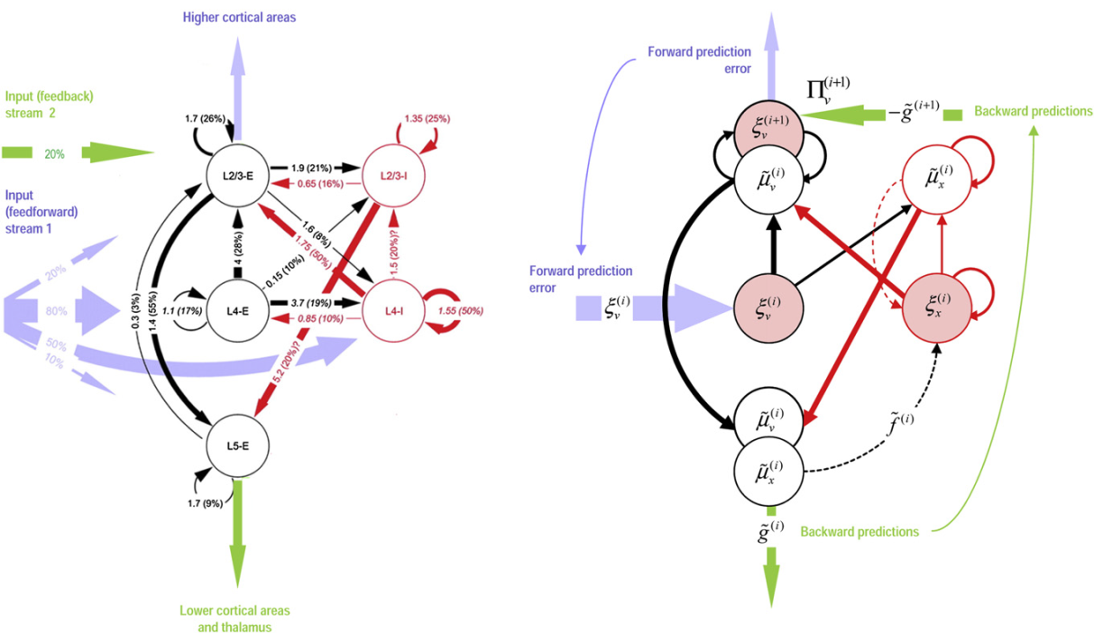
Canonical microcircuits for predictive coding
Haeusler and Maass: Cereb. Cortex 2006;17:149-162
Bastos et al: Neuron 2012; 76:695-711

Slide 10

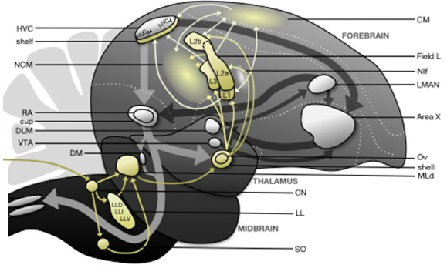
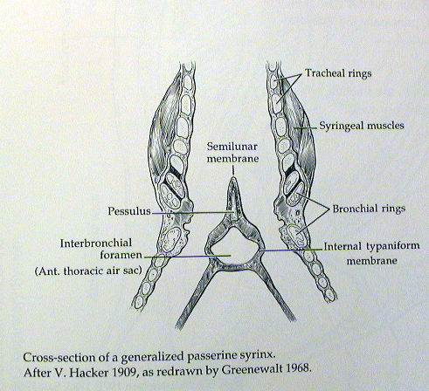

David Mumford
Perception
Prediction error (superficial pyramidal cells)
Higher vocal centre
Expectations (deep pyramidal cells)
Area X
Hypoglossal Nucleus
Thalamus
Action

Slide 11
Interim summary
Hierarchical predictive coding is a neurobiological plausible scheme that the brain might use for (approximate) Bayesian inference about the causes of sensations
Predictive coding requires the dual encoding of expectations and errors, with reciprocal (neuronal) message passing
Much of the known neuroanatomy and neurophysiology of cortical architectures is consistent with the requisite message passing

Slide 12
Hermann von Helmholtz
“It is the theory of the sensations of hearing to which the theory of music has to look for the foundation of its structure." (Helmholtz, 1877 p.4)
‘Helmholtz, H. (1877). “On the Sensations of Tone as a Physiological Basis for the Theory of Music", Fourth German edition,; translated, revised, corrected with notes and additional appendix by Alexander J. Ellis. Reprint: New York, Dover Publications Inc.,1954

Slide 13
Overview
The anatomy of inference predictive coding
graphical models
canonical microcircuits
Birdsong perceptual categorization
sensory attenuation
a birdsong duet

Slide 14
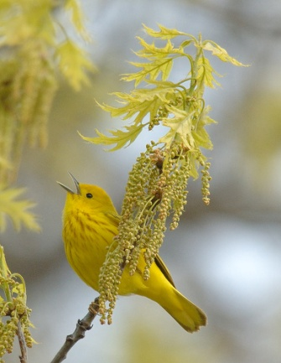
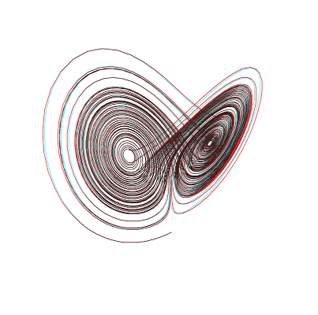




Generating bird songs with attractors
Higher vocal center
Syrinx
Sonogram
Frequency
Hidden causes
Hidden states
0.5
1
1.5
time (sec)

Slide 15
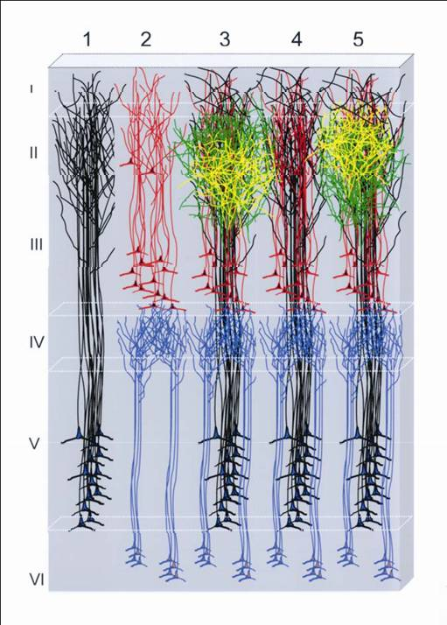
prediction and error
20
15
Predictive coding and message passing
10
5
0
-5
10
20
30
40
50
60
Descending predictions
causal states
20
stimulus
15
5000
10
4500
5
4000
Ascending prediction error
0
3500
-5
3000
hidden states
-10
10
20
30
40
50
60
2500
20
2000
0.2
0.4
0.6
0.8
15
time (seconds)
10
5
0
-5
10
20
30
40
50
60

Slide 16



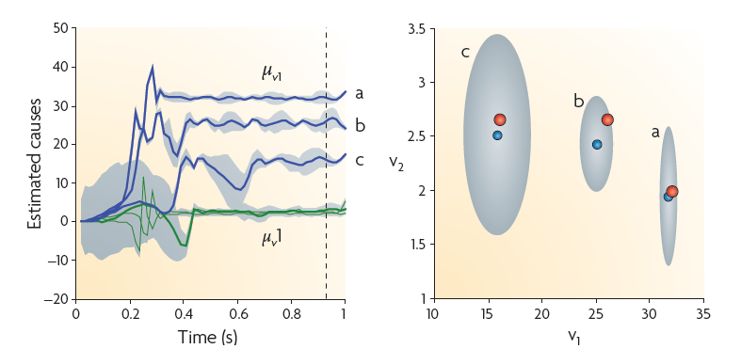
Perceptual categorization
Song a
Song b
Song c
Frequency (Hz)
time (seconds)

Slide 17
Overview
The anatomy of inference predictive coding
graphical models
canonical microcircuits
Birdsong perceptual categorization
sensory attenuation
a birdsong duet

Slide 18
Active inference: creating your own sensations
Higher vocal centre
Motor commands (proprioceptive predictions)
Corollary discharge
(exteroceptive predictions)
Area X
Hypoglossal Nucleus
Thalamus

Slide 19
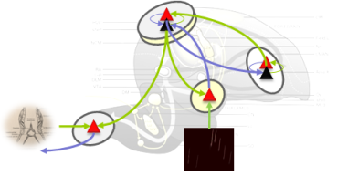
Active inference and sensory attenuation

Slide 20
Active inference and sensory attenuation
Mirror neuron system

Slide 21
Overview
The anatomy of inference predictive coding
graphical models
canonical microcircuits
Birdsong perceptual categorization
sensory attenuation
a birdsong duet

Slide 22



percept
5000
4500
4000
Frequency (Hz)
3500
3000
2500
1
2
3
4
5
6
7
time (sec)
First level expectations (hidden states)
100
50
0
-50
0
1
2
3
4
5
6
7
8
time (seconds)
Second level expectations (hidden states)
80
60
40
20
0
-20
-40
0
1
2
3
4
5
6
7
8
time (seconds)

Slide 23

percept
5000
4500
4000
Frequency (Hz)
3500
Active inference and communication
3000
2500
1
2
3
4
5
6
7
time (sec)
First level expectations (hidden states)
100
50
0
-50
0
1
2
3
4
5
6
7
8
time (seconds)
Second level expectations (hidden states)
80
60
40
20
0
-20
-40
0
1
2
3
4
5
6
7
8
time (seconds)

Slide 24
Mutual prediction and synchronization of chaos
No synchronization
Synchronization
50
60
40
50
30
40
20
30
second level expectations (second bird)
second level expectations (second bird)
10
20
0
10
-10
0
-20
-10
-30
-20
-20
-10
0
10
20
30
40
50
60
-20
-10
0
10
20
30
40
50
60
second level expectations (first bird)
second level expectations (first bird)
synchronization manifold

Slide 25
Hermann von Helmholtz
"There is nothing in the nature of music itself to determine the pitch of the tonic of any composition...In short, the pitch of the tonic must be chosen so as to bring the compass of the tones of the piece within the compass of the executants, vocal or instrumental.” (Helmholtz, 1877 p. 310)
‘Helmholtz, H. (1877). “On the Sensations of Tone as a Physiological Basis for the Theory of Music", Fourth German edition,; translated, revised, corrected with notes and additional appendix by Alexander J. Ellis. Reprint: New York, Dover Publications Inc.,1954

Slide 26
Thank you
And thanks to collaborators:
Rick Adams
Andre Bastos
Sven Bestmann
Harriet Brown
Jean Daunizeau
Mark Edwards
Xiaosi Gu
Lee Harrison
Stefan Kiebel
James Kilner
Jérémie Mattout
Rosalyn Moran
Will Penny
Lisa Quattrocki Knight
Klaas Stephan
And colleagues:
Andy Clark
Peter Dayan
Jörn Diedrichsen
Paul Fletcher
Pascal Fries
Geoffrey Hinton
James Hopkins
Jakob Hohwy
Henry Kennedy
Paul Verschure
Florentin Wörgötter
And many others

